Slide 1
Final Project:
Channel-Agnostic Strategies in Deep Learning for EEG
Soren Madsen
Justin Goh

Slide 2
Objective: Improve deep learning techniques for motor imagery classification.

Slide 3
Related Work: High Gamma Dataset
High quality motor imagery dataset:
14 subjects with over 800 trials each
4.5 second event time
4 classes: left hand, right hand, feet, rest
128 electrodes
Introduce SOTA model architectures:
Shallow ConvNet
Deep ConvNet

Slide 4
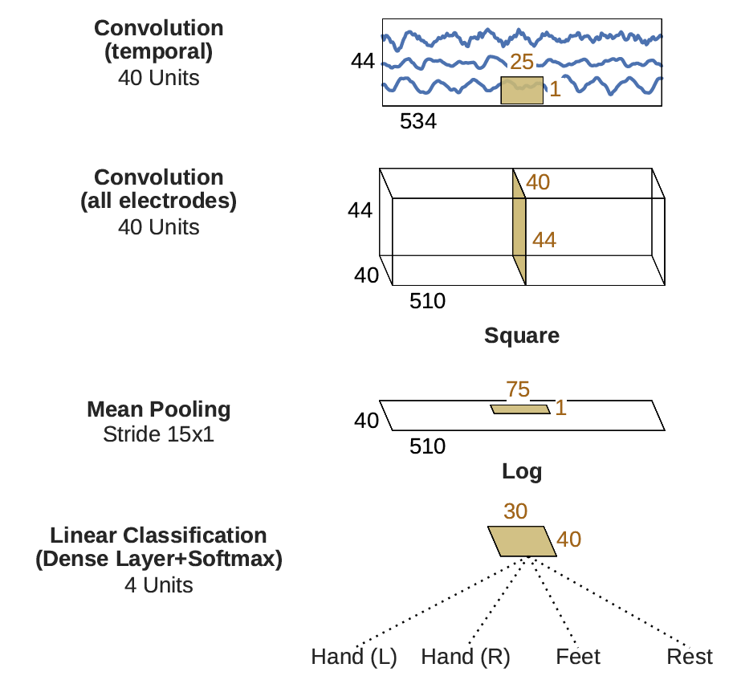
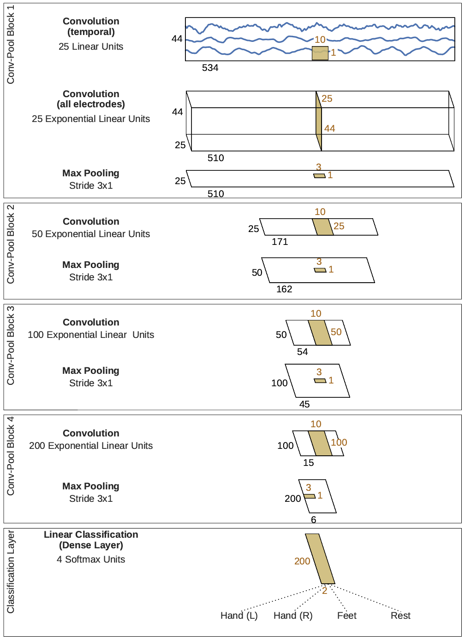
Related Work: Shallow & Deep ConvNet
Deep
Shallow

Slide 5
Related Work: Shallow & Deep ConvNet
Results
Key Strategies:
Cropped training strategy
High pass filtering
BatchNorm and ELU
Data | FBCSP | Shallow | Deep
0-f_{end} Hz | 91.2 | 90.3 | 92.5
4-f_{end} Hz | 90.9 | 93.0 | 91.4

Slide 6
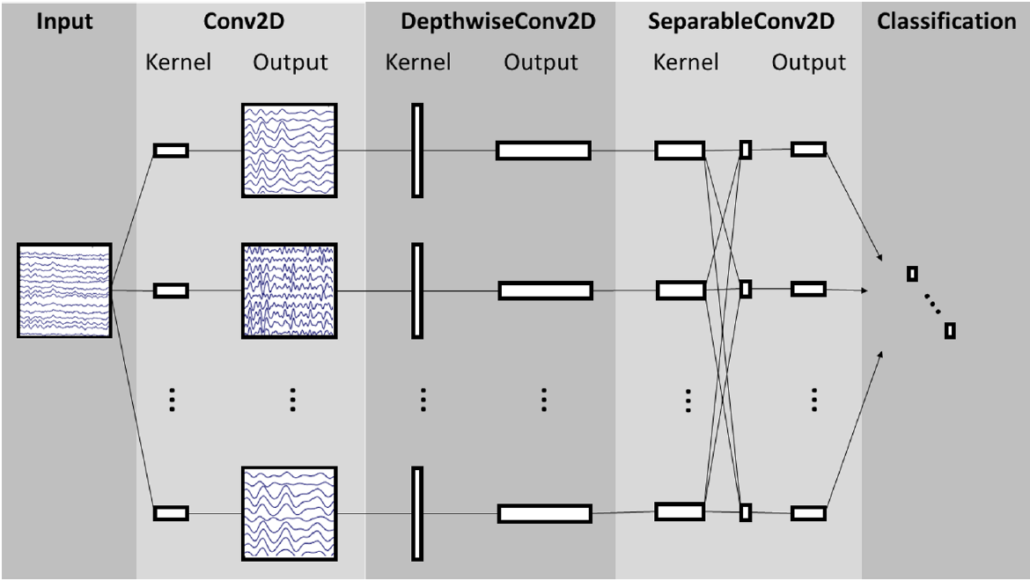
Related Work: EEGNet

Slide 7
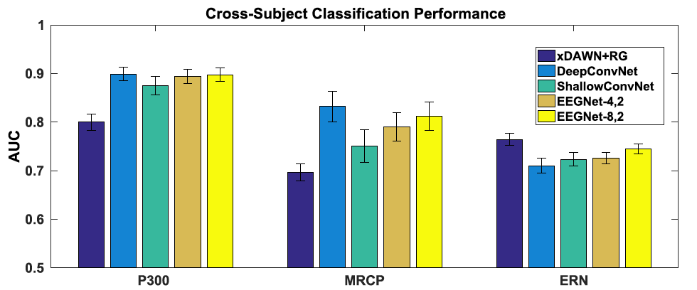
Related Work: EEGNet

Slide 8
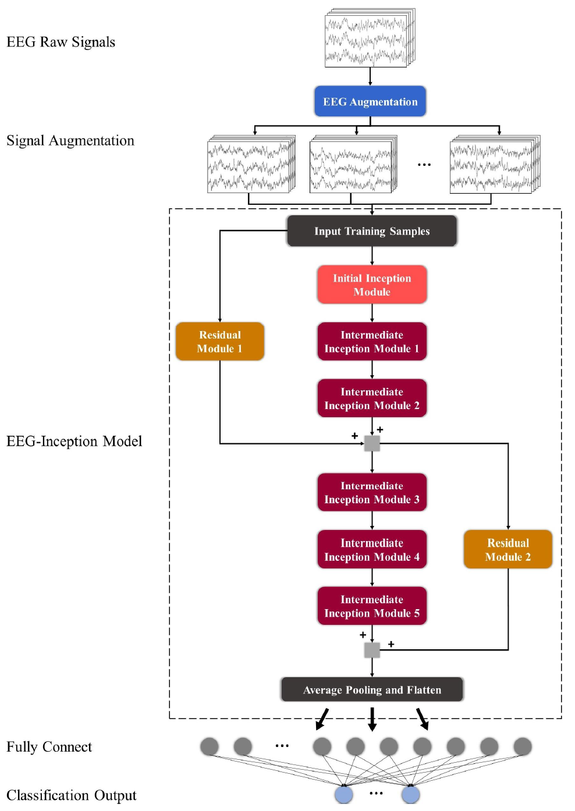
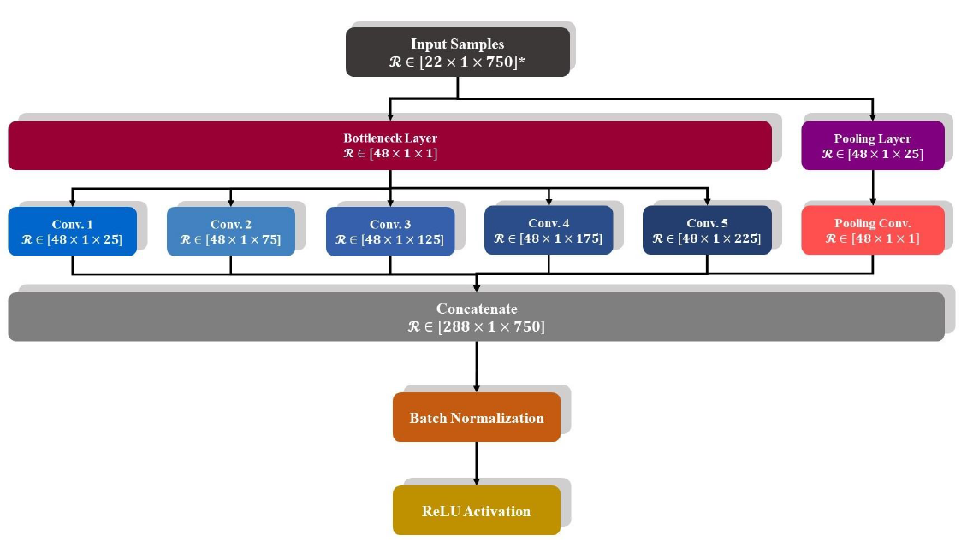
Related Work: EEG-Inception

Slide 9
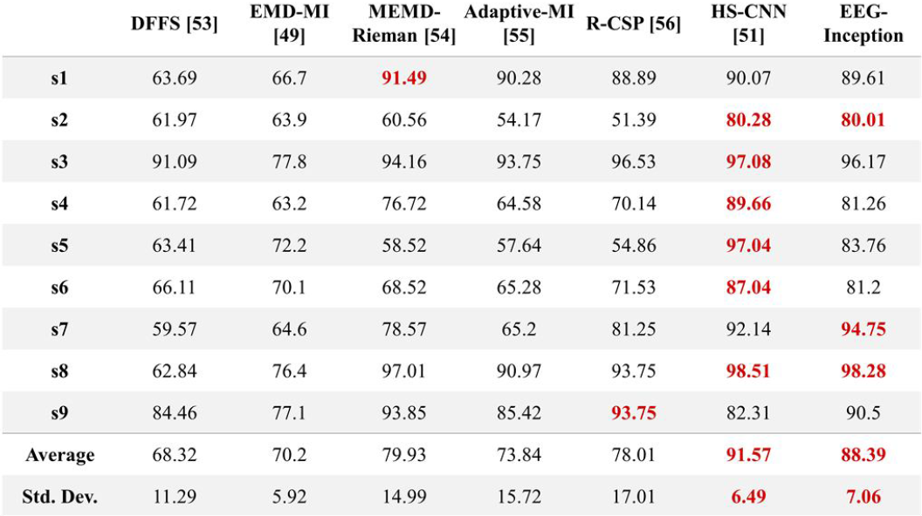
Related Work: EEG-Inception

Slide 10
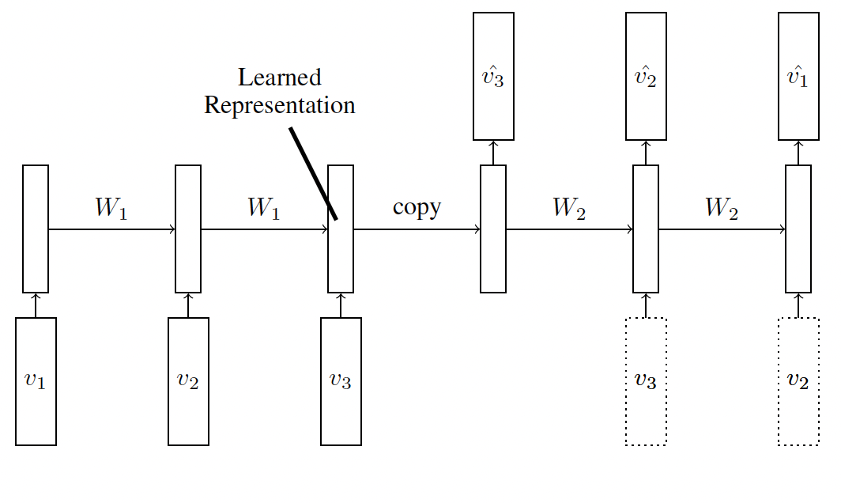
Related Work: LSTM Autoencoder
Takes input sequence - learns representation of sequence
Decodes learned representation
Reconstruct input sequence
Predict future sequence
Uses LSTM blocks for encoder & decoders

Slide 11
End-to-end deep learning solutions suffer from brittle design that restricts the use of the trained model to devices that mimic the hardware setup used in the original publication.

Slide 12

Key Questions
Can we find a channel agnostic form for EEG data on which to train?
Does this new form reduce the data well?
What other techniques of data reduction might be useful?
Can we maintain SOTA performance?

Slide 13
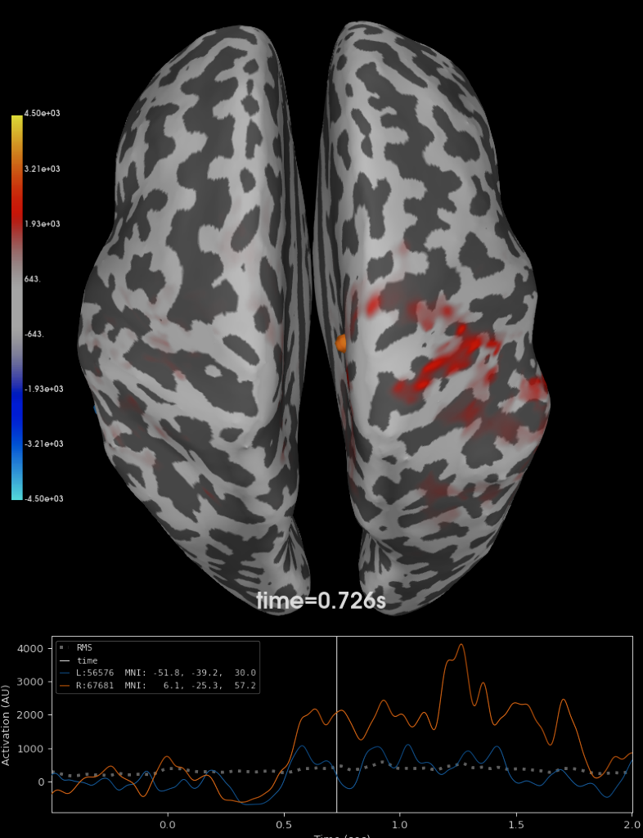
Initial Exploration
Develop channel-agnostic representation of brain activity
Digital filtering, resampling, and artifact removal of EOG and EMG
What does this form look like?
Topographical?
Cortical surface map?
Beamforming?
Dynamic Imaging of Coherent Sources (DICS)

Slide 14
Big Challenges
Magnitude of data we were creating and training on (over 3.5 Petabytes)
Training data didn’t have head models for subjects
Too many assumptions about the mechanics to have explainable results
What next?

Slide 15
The Pivot:
Channel-Reduction Strategies in Deep Learning for EEG
Soren Madsen
Justin Goh

Slide 16
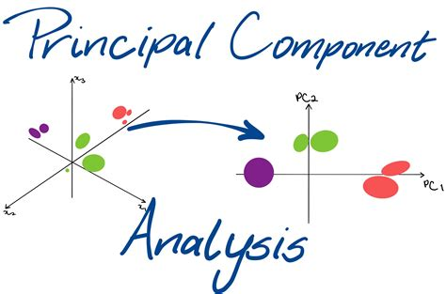
The New Approach (part 1)
Channel Reduction Methods:
PCA
KPCA with kernel types:
Linear
Polynomial
Radial basis function
Sigmoid
Cosine
LSTM Autoencoder
https://towardsdatascience.com/understanding-principal-component-analysis-ddaf350a363a
Notes:
https://towardsdatascience.com/understanding-principal-component-analysis-ddaf350a363a

Slide 17
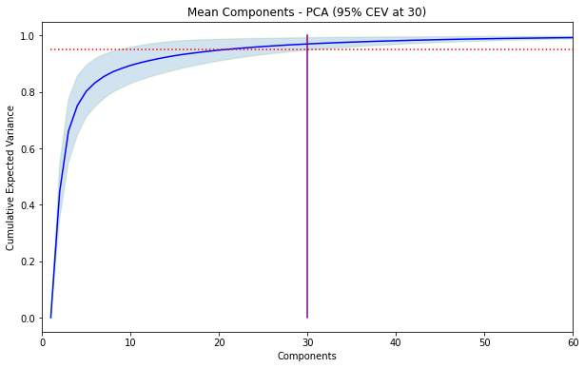
Principal Components Analysis
Compute covariance matrix
Find eigenvalues and eigenvectors
Retain only the number of components necessary to capture variance

Slide 18
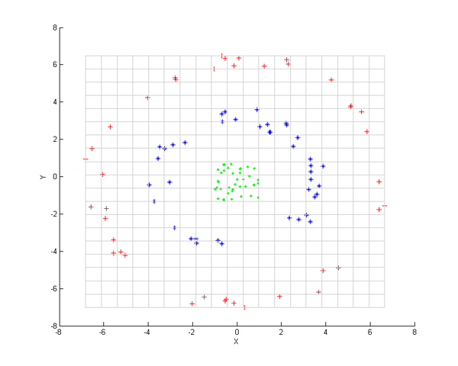
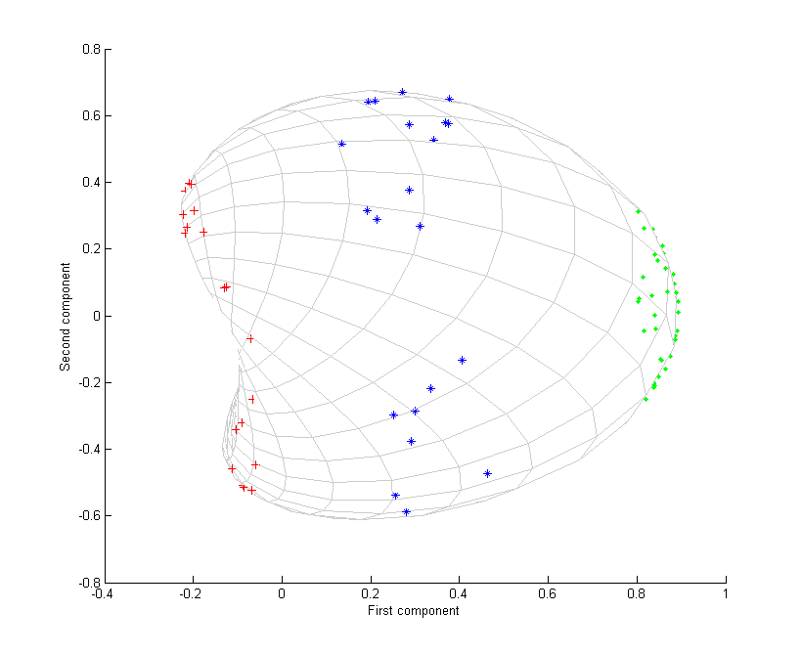
Kernel PCA
Dimensionality reduction via kernel function transformation before PCA
Gaussian
https://en.wikipedia.org/wiki/Kernel_principal_component_analysis

Slide 19
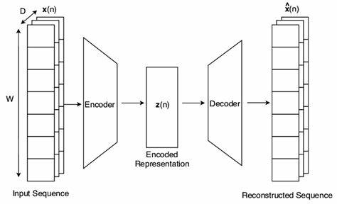
LSTM Autoencoder
Deep learning dimensionality- reduction approach
Condense data into smaller, encoded representation
Then, recreate the original sequence

Slide 20
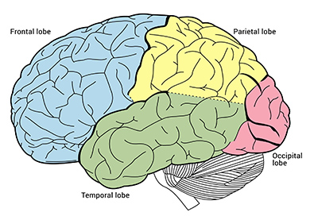
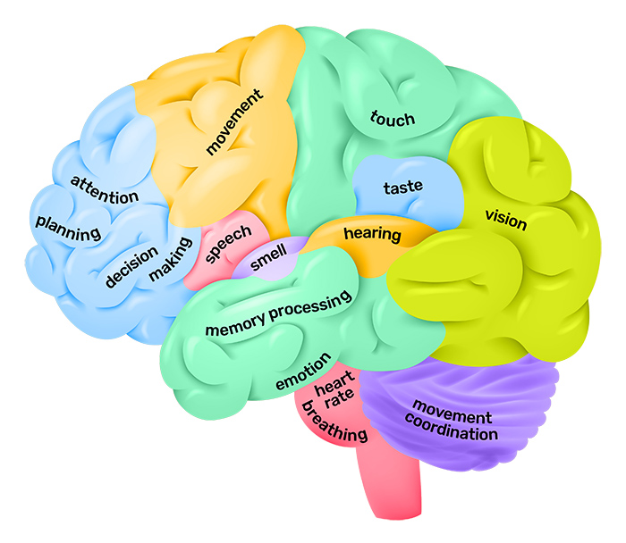
The New Approach (part 2)
Channel Selection Methods:
Which electrodes contribute most to accurate readings?
Frontal lobe
Temporal lobe
Parietal lobe
Occipital lobe
https://qbi.uq.edu.au/brain/brain-anatomy/lobes-brain

Slide 21
Experimental Setup

Slide 22
Data Preparation and Model Training
All models trained on High Gamma Dataset with simple preprocessing
Low pass: 5Hz
High pass: 120 Hz
Resample: 250Hz
ICA artifact removal: 20 components
Dimensionality reduction and channel selection
Trained on whole trial vs. cropped trials (time-saving)
Loss: Negative Log-Likelihood

Slide 23
Hyperparameters:
L2 Regularization: 0.01 - 0.1
Encourages sparsity in weights
Batch Size: 30 - 90
Utilizes GPU memory on WAVE
Optimizer: Adam
Common, captures statistical trends in loss to augment learning rate

Slide 24
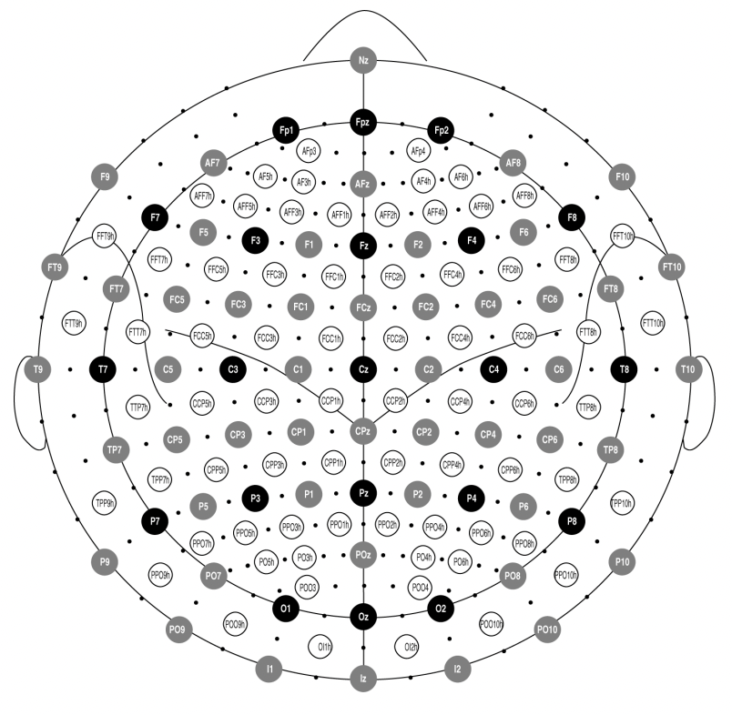
Channel Selection
10-5 system
Extension of 10-20 system
128 electrodes
Distance to adjacent electrode, 5% or 10% percent of total front-back, left-right distance of the skull

Slide 25
Results
PCA & KPCA

Slide 26
Validation Accuracy of Models Trained on Dimensionality-Reduction Datasets
Model | PCA | Linear KPCA | Poly KPCA | RBF KPCA | Sigmoid KPCA | Cosine KPCA | Baseline
Shallow ConvNet | 79.6 | 39.4 | 35.6 | 35.9 | 40.6 | 37.4 | 91.9
Deep ConvNet | 63.6 | 35.3 | 32.1 | 33.3 | 36.2 | 34.8 | 86.3
EEGNet | 75.2 | 41.8 | 35.2 | 36.3 | 40.4 | 38.5 | 82.2
EEG-Inception | 63.6 | 35.8 | 31.1 | 31.1 | 36.5 | 35.0 | 74.8

Slide 27
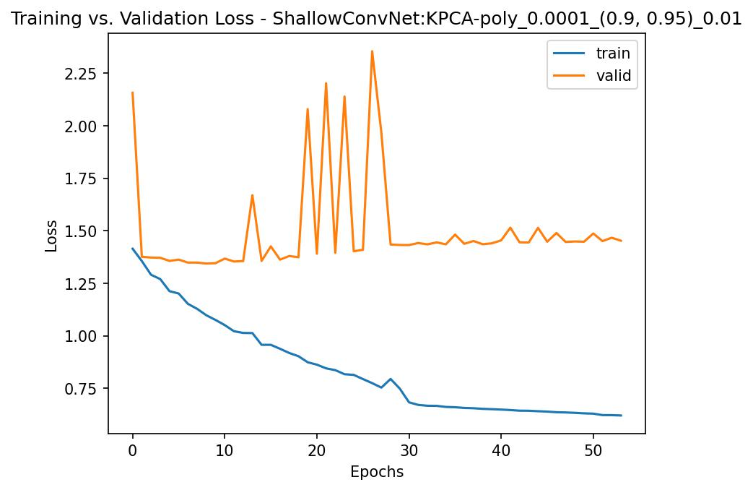
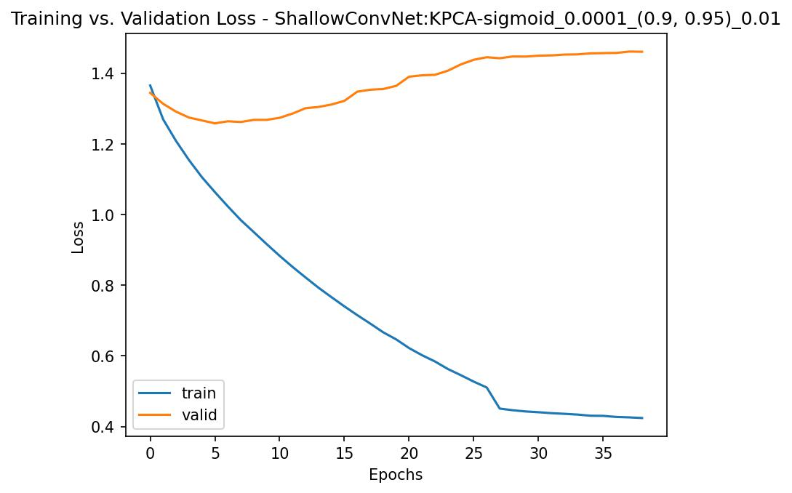
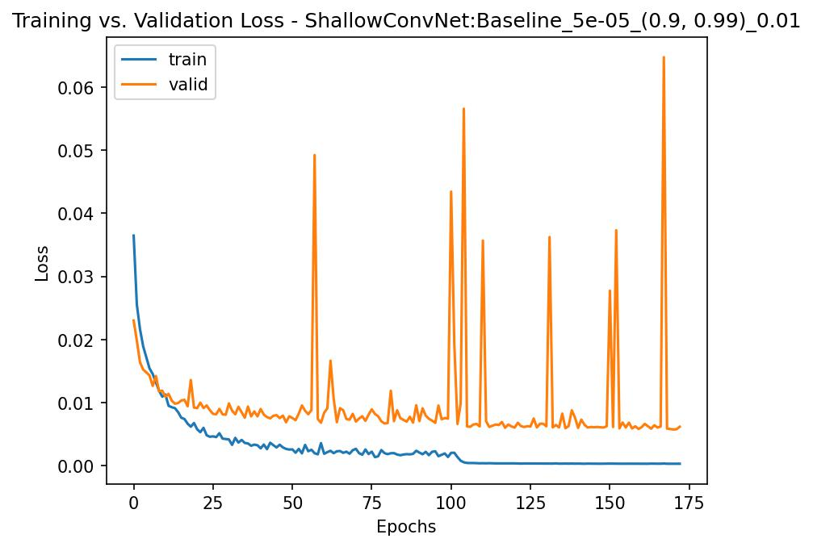
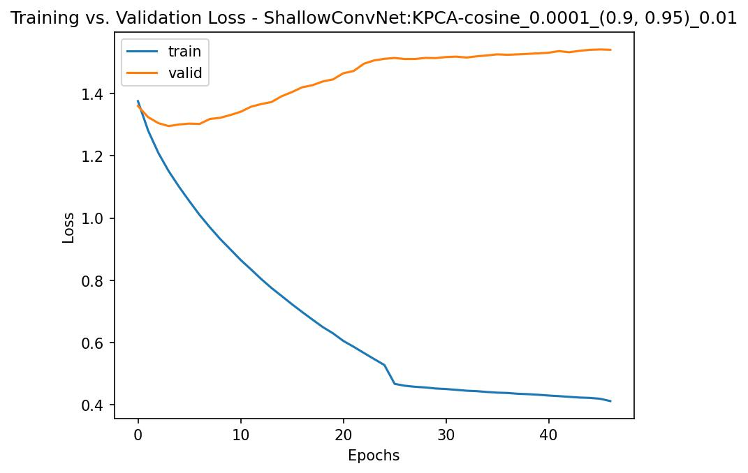
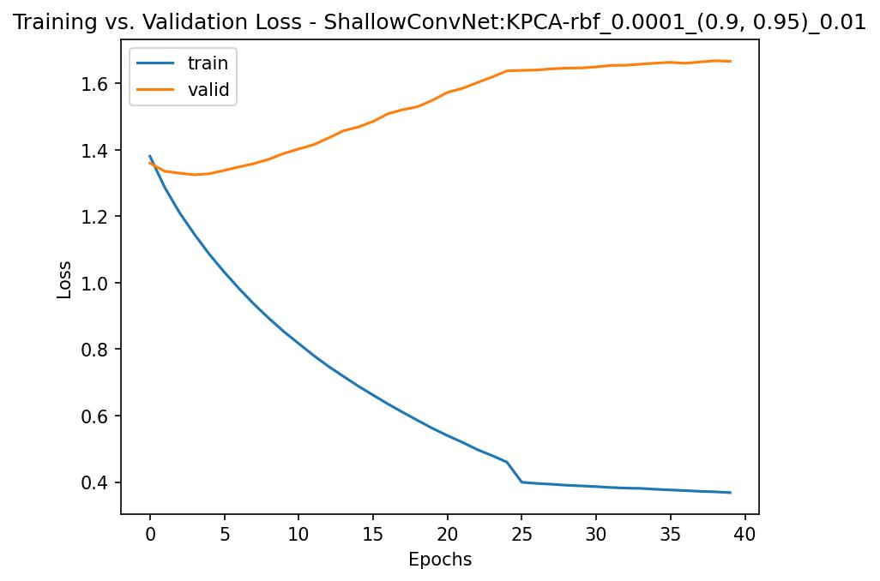
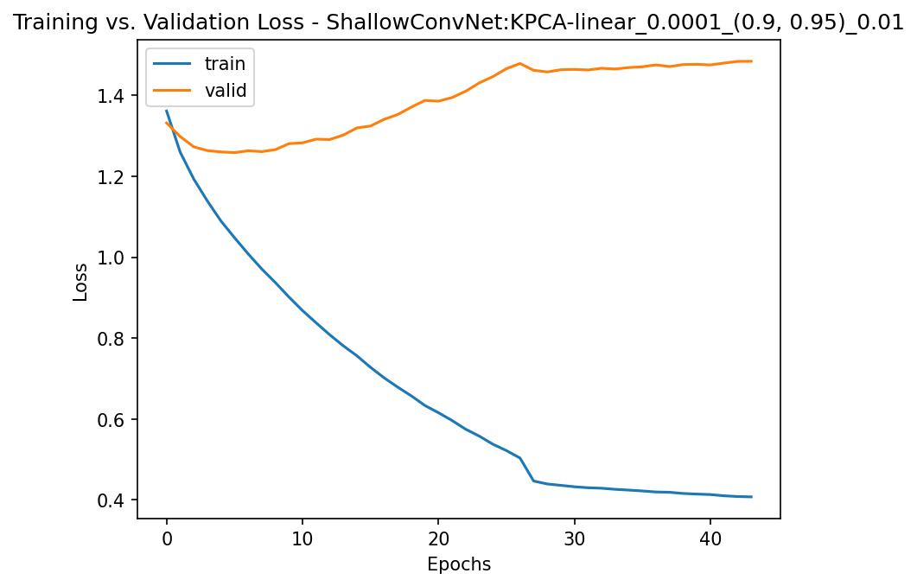
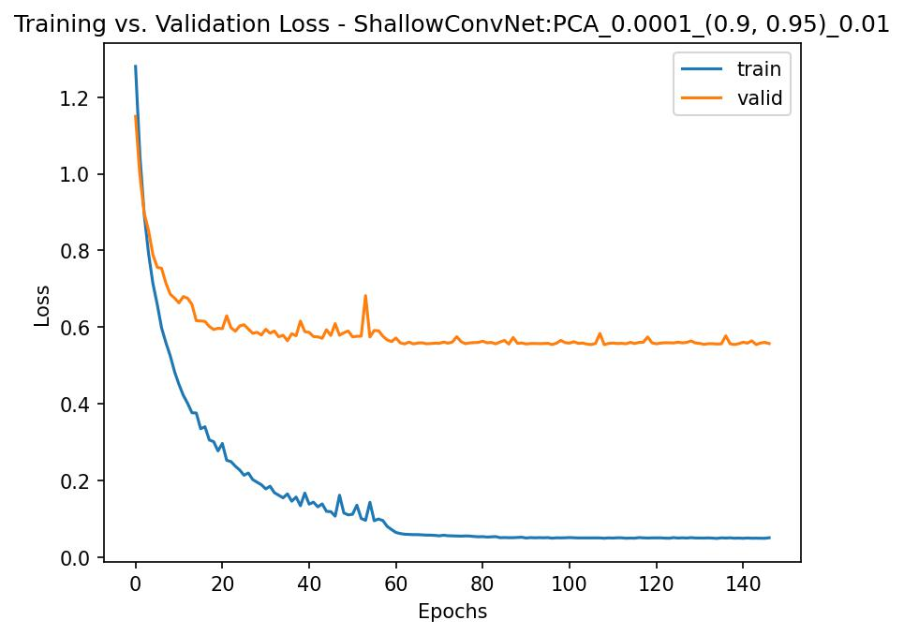
Shallow ConvNet

Slide 28
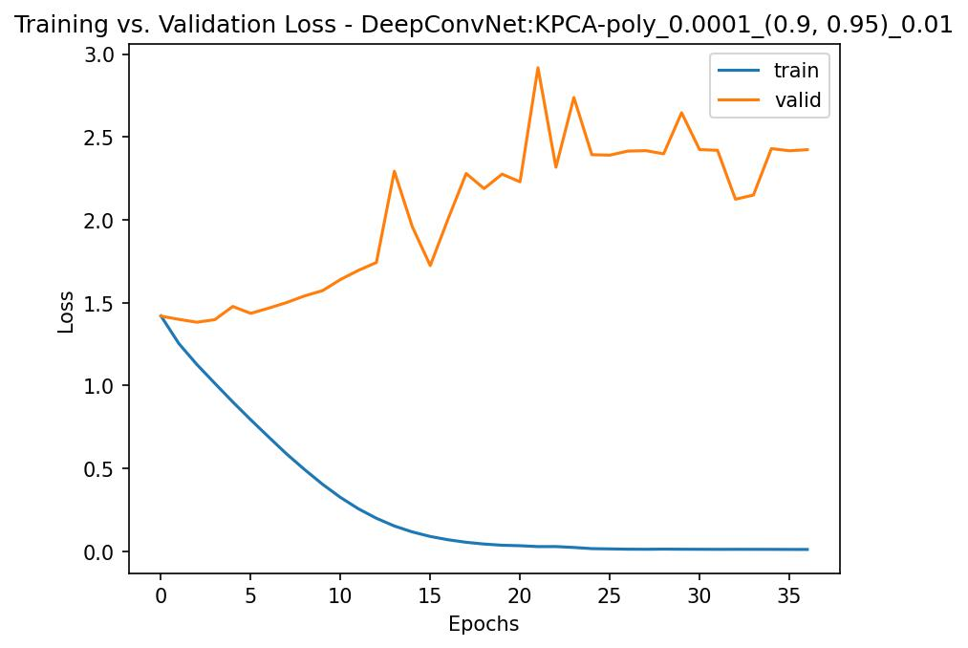
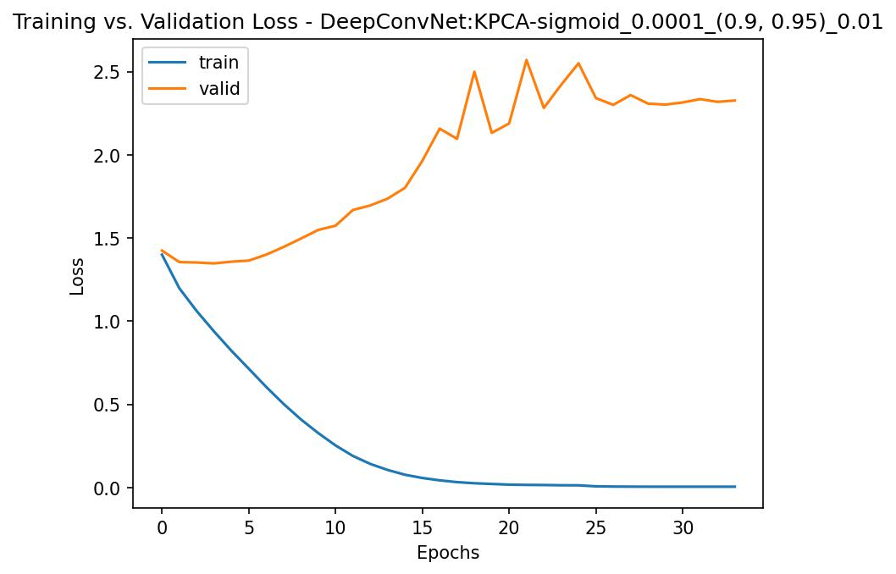
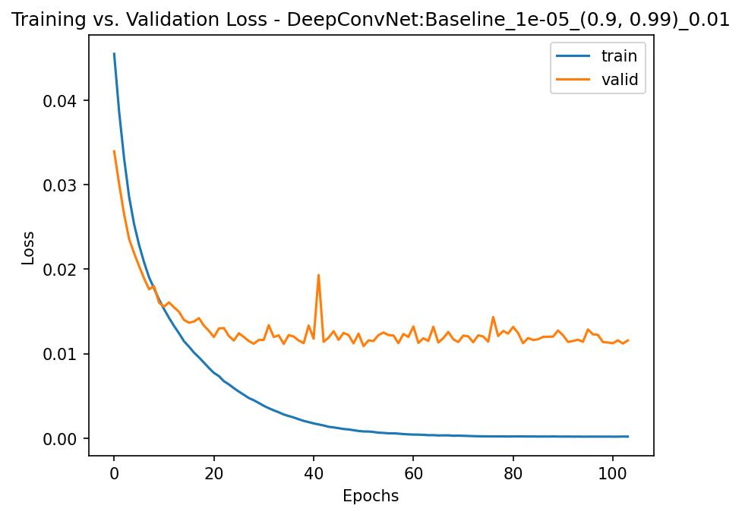
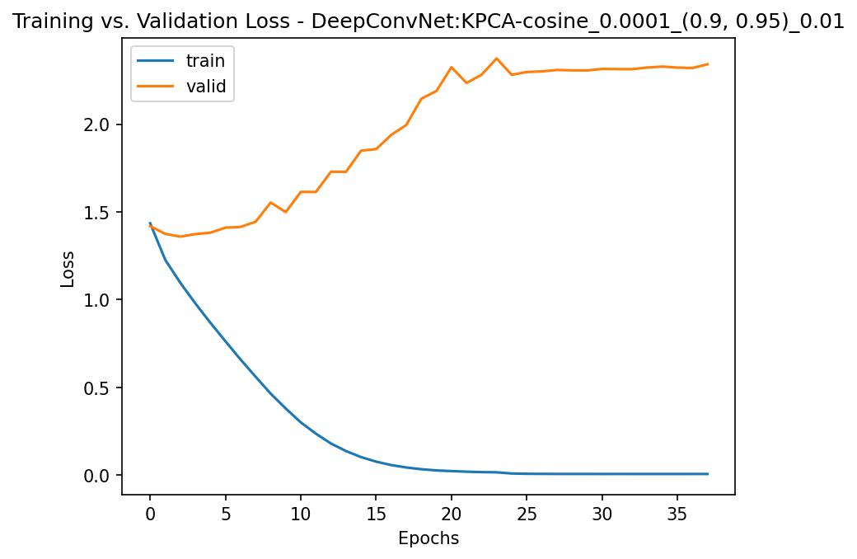
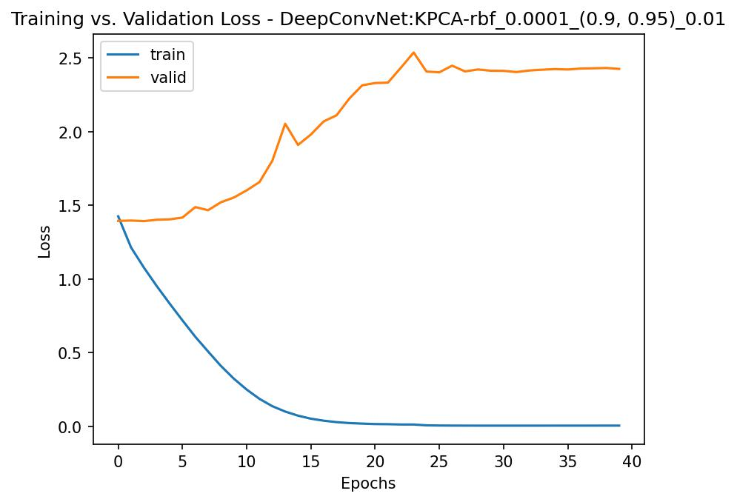
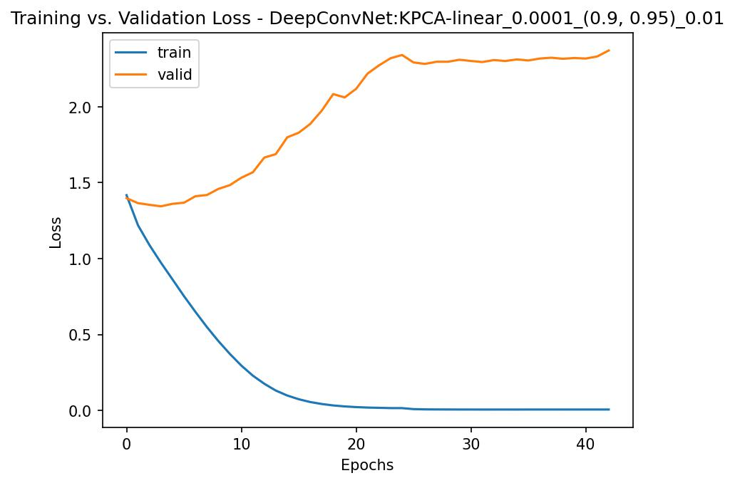
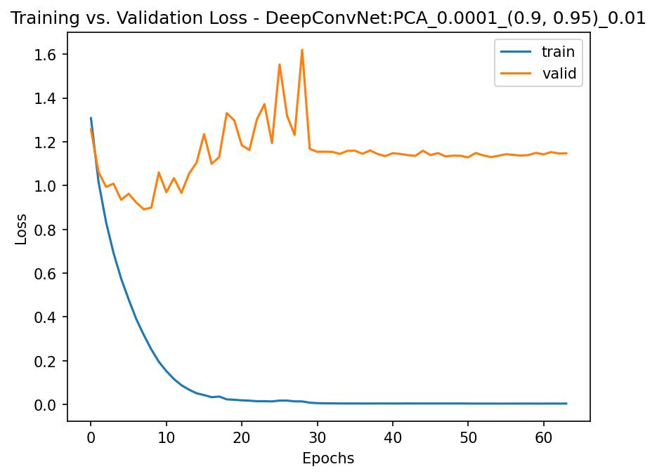
Deep ConvNet

Slide 29
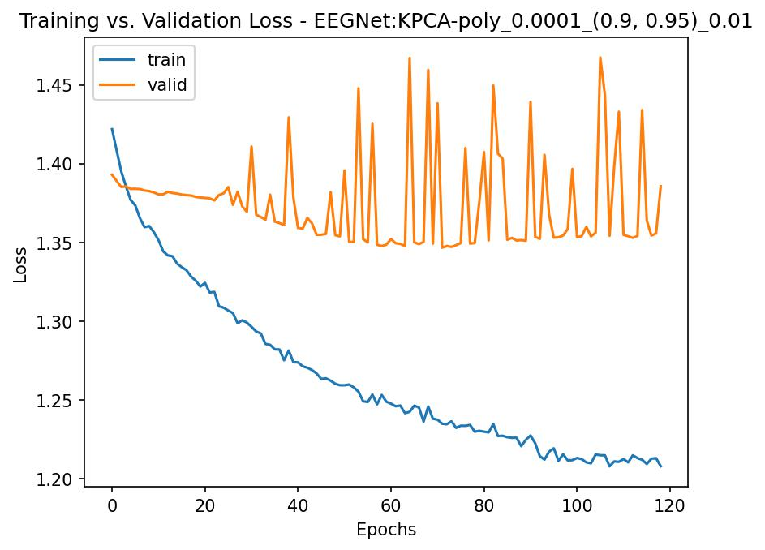
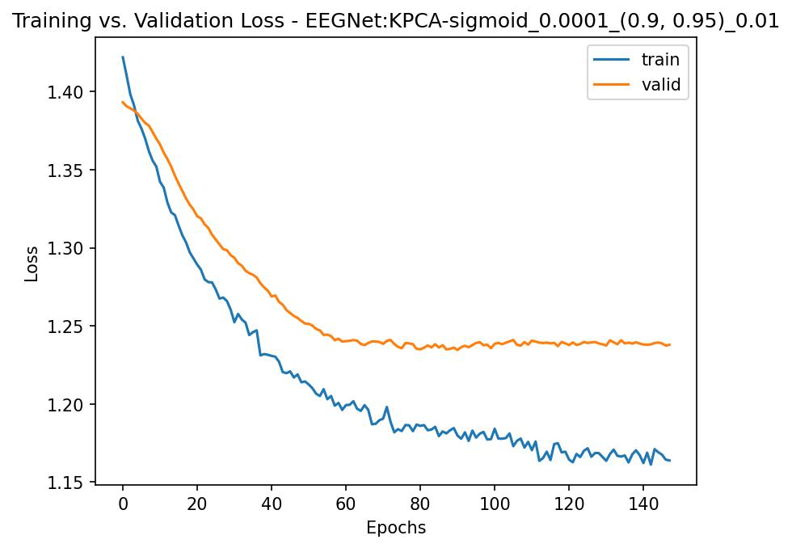
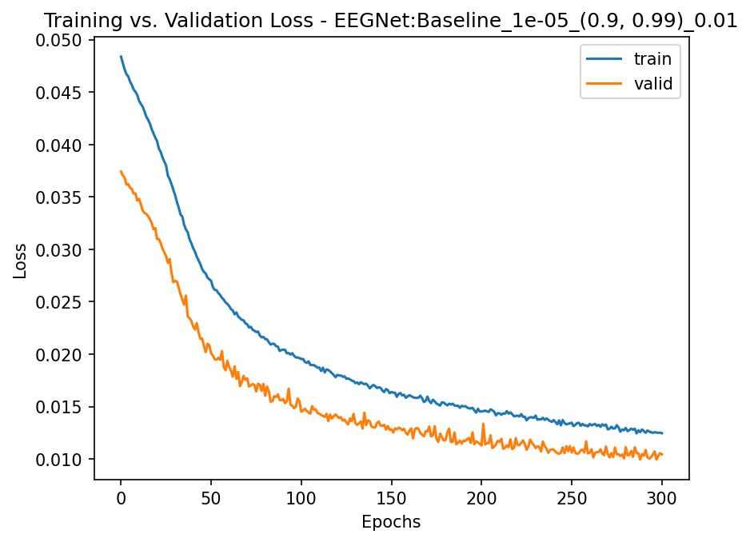
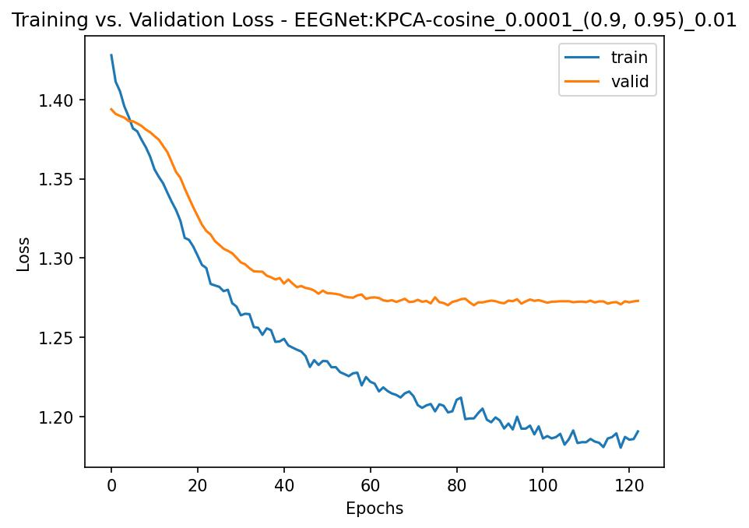
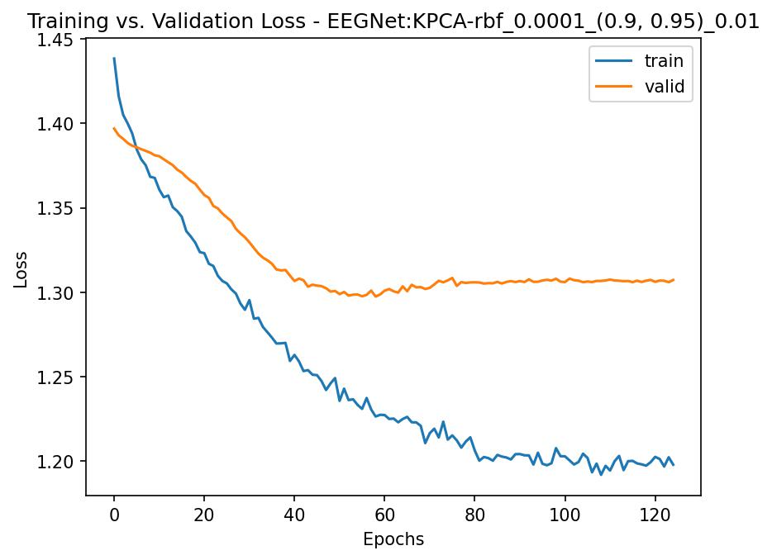
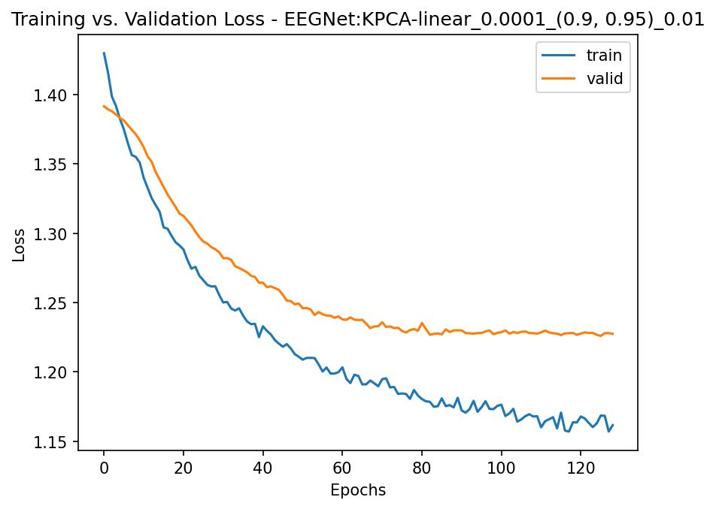
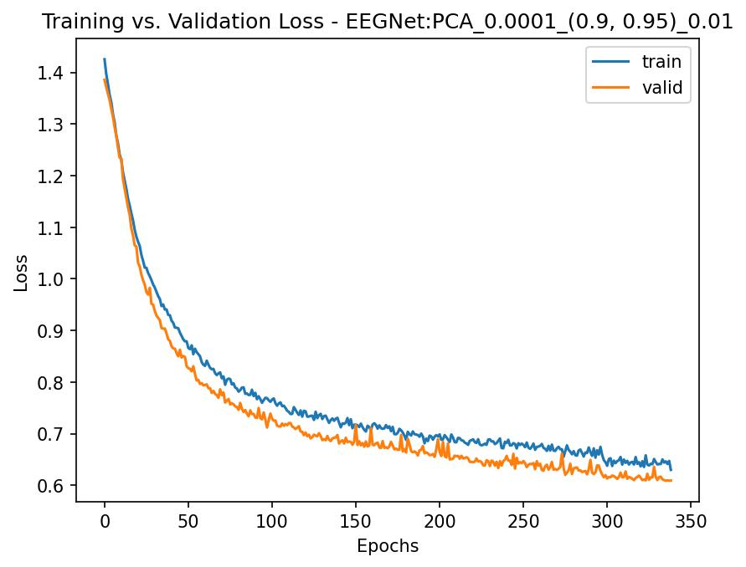
EEGNet

Slide 30
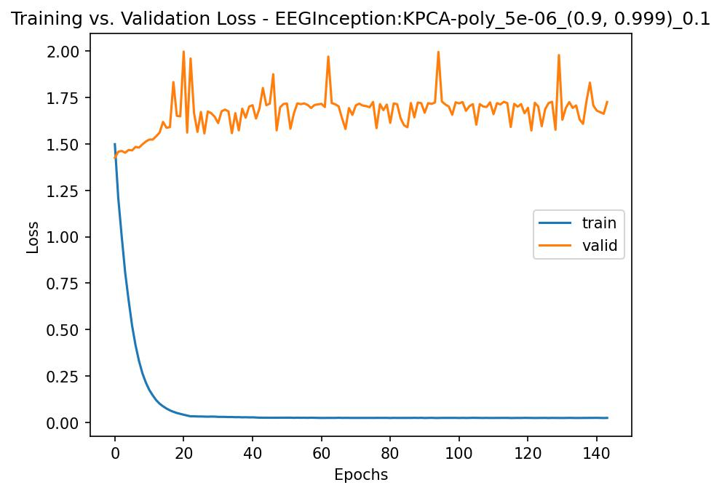
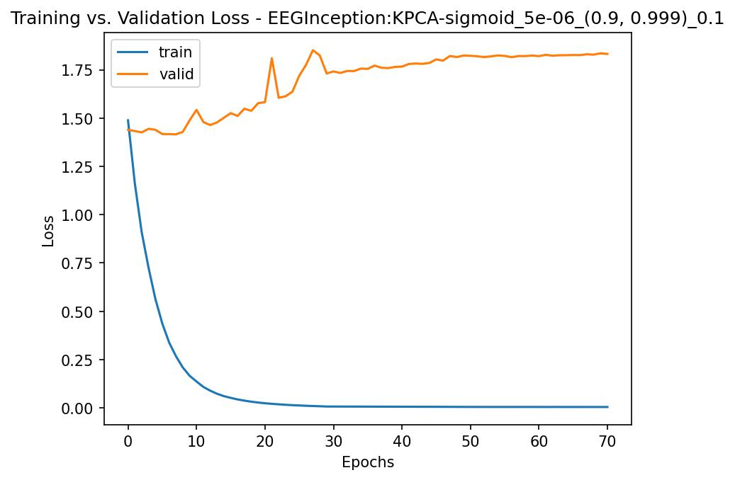
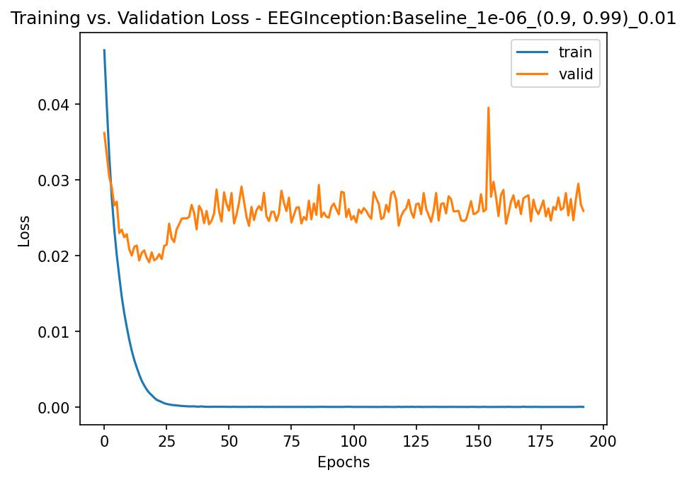
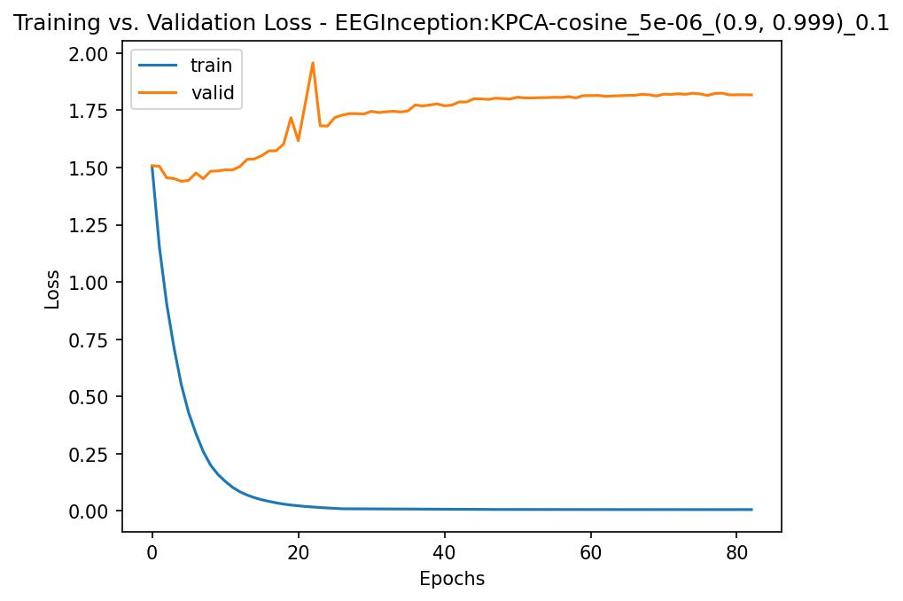
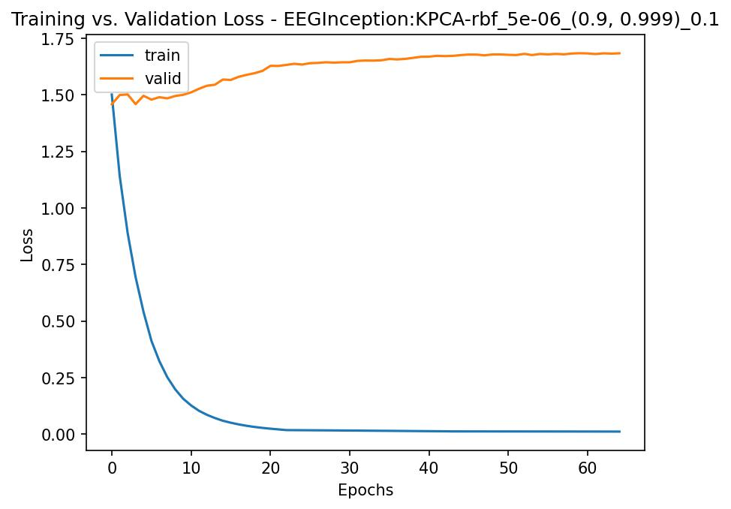
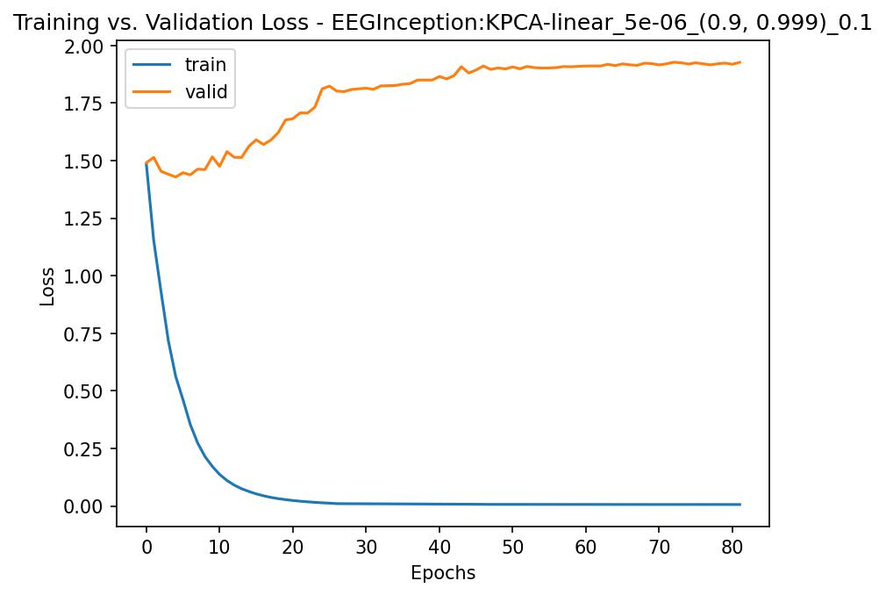
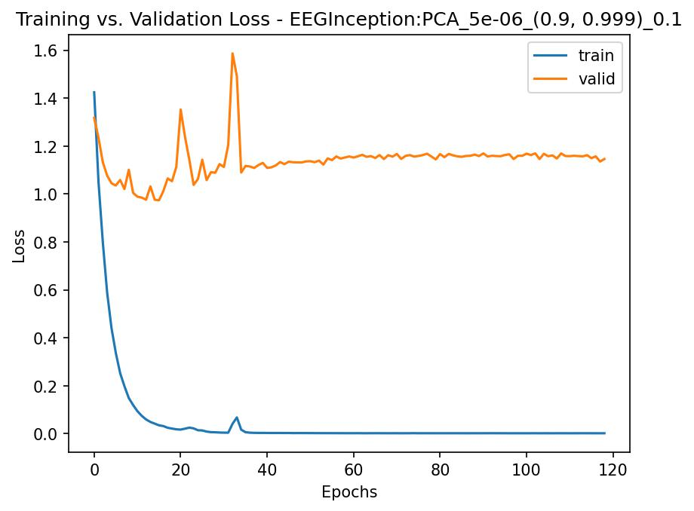
EEG-Inception

Slide 31
Test Accuracy of Models Trained on Dimensionality-Reduction Datasets
Model | PCA | Linear KPCA | Poly KPCA | RBF KPCA | Sigmoid KPCA | Cosine KPCA | Baseline
Shallow ConvNet | 40.6 | 37.0 | 33.0 | 33.3 | 36.3 | 33.9 | 85.3
Deep ConvNet | 42.0 | 34.0 | 29.7 | 31.6 | 32.1 | 33.2 | 83.1
EEGNet | 45.6 | 38.3 | 29.3 | 34.8 | 37.4 | 38.5 | 82.2
EEG-Inception | 43.4 | 35.1 | 30.9 | 28.8 | 32.7 | 33.7 | 70.9

Slide 32
Results
Autoencoder

Slide 33
 | Validation |  | Test
Model | Autoencoder (30) | Baseline (128) | Autoencoder (30) | Baseline (128)
Shallow ConvNet | 75.76 | 91.9 | 73.75 | 85.3
Deep ConvNet | 72.16 | 86.3 | 68.39 | 83.1
EEGNet | 68.29 | 82.2 | 65.98 | 82.2
EEG-Inception | 66.51 | 74.8 | 64.76 | 70.9

Slide 34
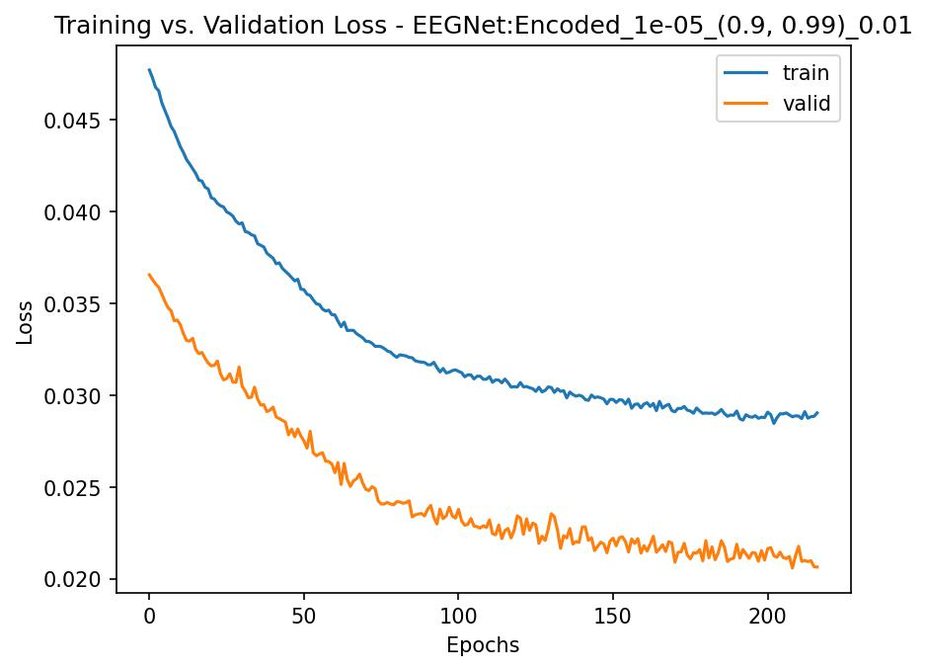
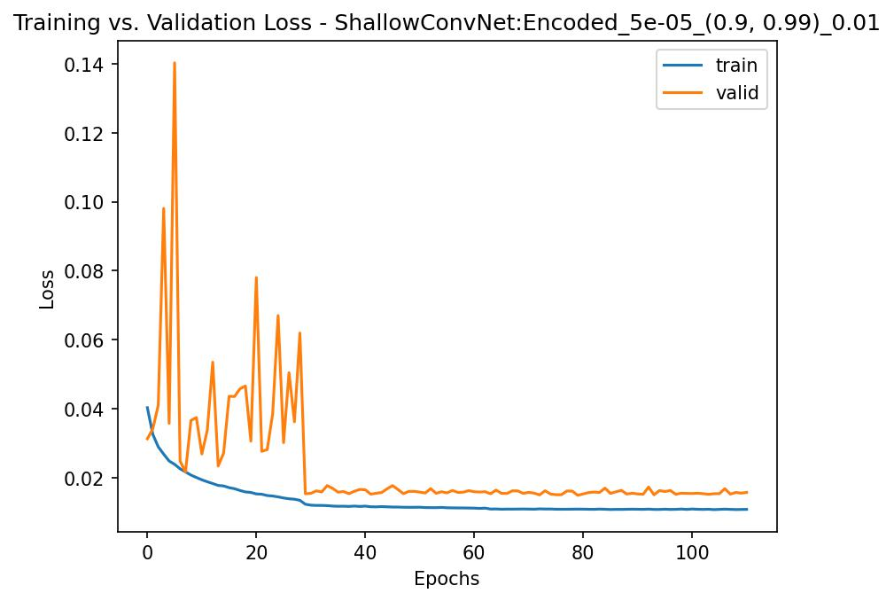
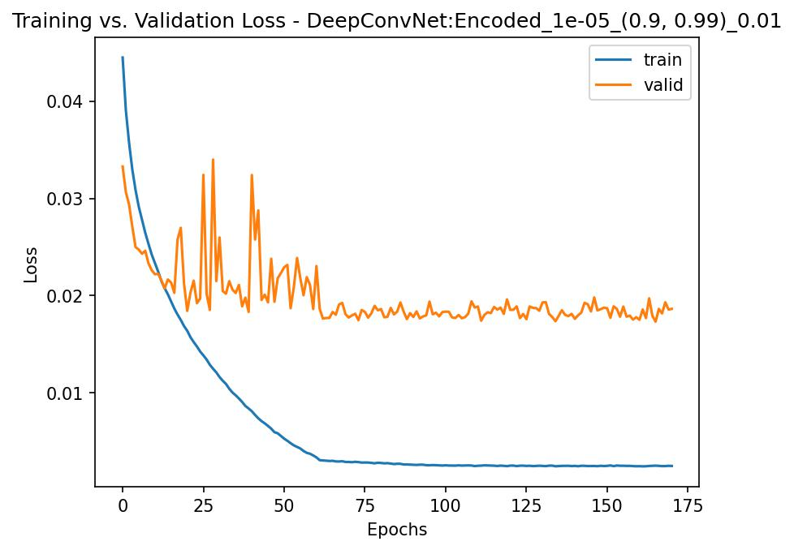
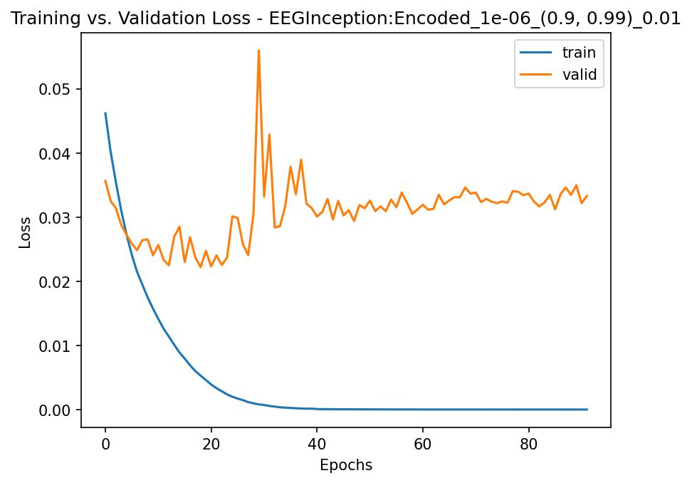
Convergence

Slide 35
Results
Channel Selection

Slide 36
Validation Accuracy of Models Trained on Channel-Selection Datasets
Model | Frontal (52) | Temporal (20) | Parietal (57) | Occipital (24) | Baseline (128)
Shallow ConvNet | 80.0 | 39.4 | 88.2 | 66.3 | 91.9
Deep ConvNet | 74.1 | 51.0 | 81.6 | 56.7 | 86.3
EEGNet | 77.8 | 60.6 | 85.9 | 58.7 | 82.2
EEG-Inception | 61.9 | 49.2 | 74.8 | 52.6 | 74.8

Slide 37
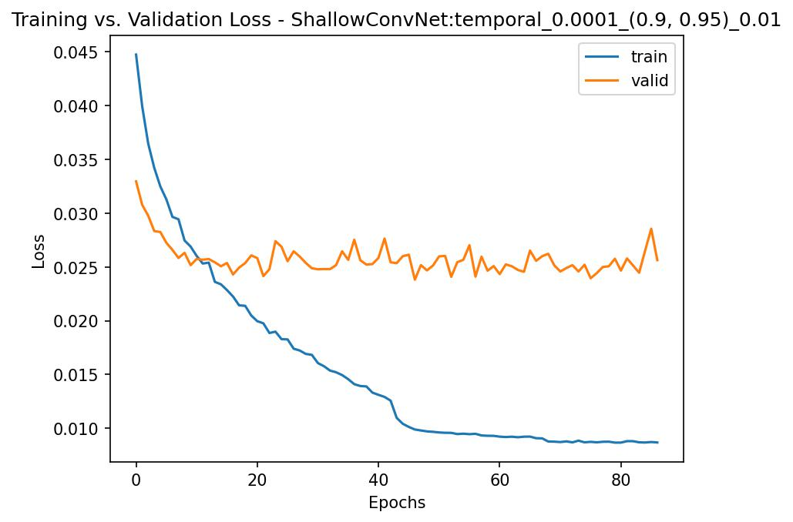



Shallow ConvNet

Slide 38




Deep ConvNet

Slide 39




EEGNet

Slide 40




EEG-Inception

Slide 41
Test Accuracy of Models Trained on Channel-Selection Datasets
Model | Frontal (52) | Temporal (20) | Parietal (57) | Occipital (24) | Baseline (128)
Shallow ConvNet | 67.9 | 56.5 | 82.1 | 62.0 | 85.3
Deep ConvNet | 66.3 | 49.2 | 76.5 | 54.1 | 83.1
EEGNet | 74.1 | 56.1 | 78.7 | 56.9 | 82.2
EEG-Inception | 58.7 | 46.9 | 69.6 | 48.3 | 70.9

Slide 42
Key Insights

Slide 43


Channel Reduction
PCA & KPCA:
Poor test performance
Transforms time-series data spatially
KPCA was done on each sample
Very memory intensive
Autoencoder:
Good test performance
Likely captures temporal relationships between samples
Very slow to train

Slide 44
Channel Selection
Which channels contribute most to the parietal subset accuracy?
Baseline: 82.1%
CCP4h: -19.5% 61.6%
CP2: -17.0% 65.1%
CCP2h: -16.6% 65.5%
CCP3h: -16.2% 65.9%
CCP1h: -15.3% 66.8%
All 5: -36.2% 45.9%
Parietal, frontal lobes most successful
Next Questions:
Channel count?
Proximity to motor cortex?
Continued our investigation into the parietal lobe

Slide 45

Channel Selection

Slide 46
Thank You

